Slide 1
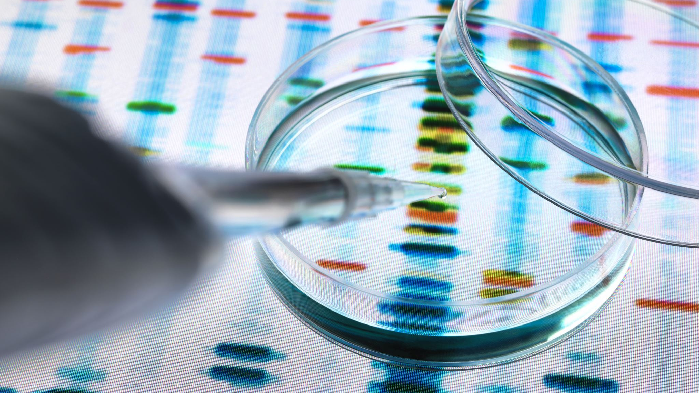
Diabetes Risk Prediction System
Presented By
Gopireddy Manichandana
Sri Geetha Devi Vegi
Harshitha Chitturi
Pavan Kumar Kandulapati

Slide 2

Contents
Introduction
Charts
Key Points
Implementation
Work Allocation

Slide 3

Introduction
Diabetes is a most common disease in these world affecting major part of the population. Although it is a global concern but still most part of population are unaware to deal with it.
Inability of pancreas to produce required insulin or inability to use it properly to convert glucose into energy is the cause of Diabetes
Diabetes majorly of 3 types :
Diabetes Mellitus
Gestational Diabetes
Diabetes Insipidus

Slide 4
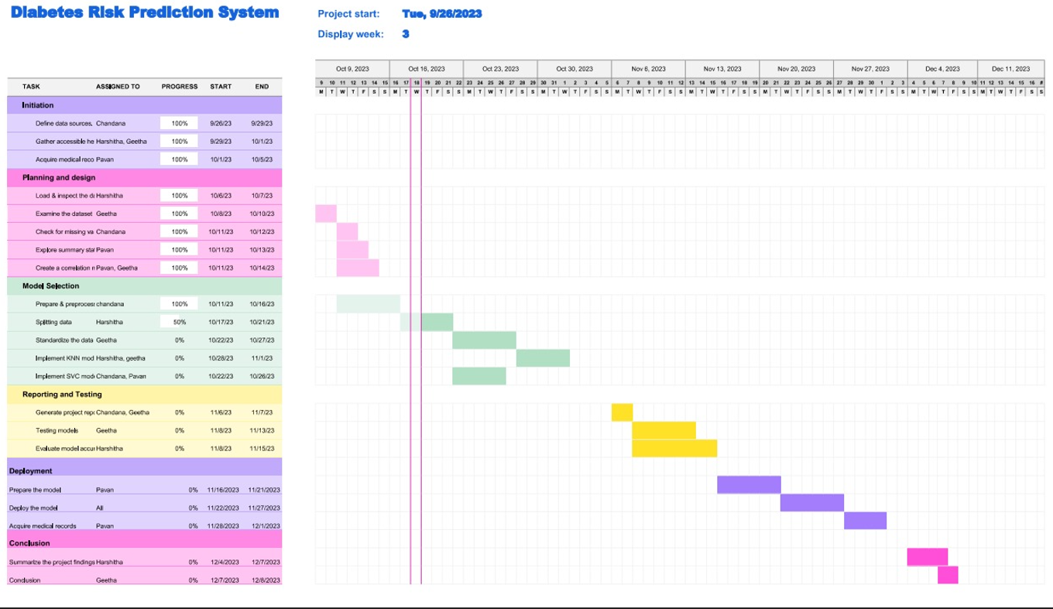
Gantt Chart

Slide 5

Key Points
Diabetes is a prevalent and widespread disease affecting a significant portion of the global population.
The project aims to develop a Data Science solution to predict whether a given individual is diabetic or not based on relevant data.
The model is built using various classification algorithms, with a focus on K-Nearest Neighbors (KNN) and Support Vector Machine (SVM).
Creating a user-friendly interface for individuals to easily input their data and receive risk predictions.
Discuss strategies for keeping the data up-to-date and maintaining the model's accuracy over time.

Slide 6
Implementation
Collect a dataset containing relevant features such as age, weight, family history, diet, physical activity, and genetic factors. Ensure the dataset includes labels indicating whether individuals are diabetic or not.
Split the dataset and testing subsets.
Choose classification algorithms for the project, such as K-Nearest Neighbors (KNN) and Support Vector Machine (SVM).
Compare the performance of different models and select the one that provides the highest accuracy in predicting diabetes risk.
Ensure that your data is privacy.

Slide 7

Thank You

